Slide 1
Cloud Adoption Framework for Azure | Plan workshop
Speaker
Title
Notes:
Welcome slide

Slide 2
Objectives of the workshop
Overview of the Cloud Adoption Framework, help understand all elements of the transition to cloud
Assist in building a cloud adoption plan or optimizing current plan
Build learning path for your teams
Establish or optimize your Azure cloud environment
At the end of this work shop you should…
Establish a plan for initial organizational alignment
Have a clear cloud adoption plan

Slide 3
Achieve balance. Deliver modernization.. Deli
Best practices
Templates
People
Process
Technology
Documentation
Tools
Control & Stability
Speed &
Results
Align—business, people and technology strategy.
Achieve—business goals with actionable, efficient, and comprehensive guidance.
Deliver—fast results with control and stability.
Notes:
Change is more than adopting technology. It’s adapting how you do business.
The Microsoft Cloud Adoption Framework for Azure means changing how you do business—not just swapping out technology, but changing your enterprise, the culture behind it, and you too.
We share best practices from our employees, partners, and customers who have already undertaken the cloud journey.
The Cloud Adoption Framework brings together people, process, and technology—a strategy that’s aligned to your business goals.
Quickly—efficiently, and with actionable guidance, it provides guidance for your organization’s agile business transformation.
Leading people through change is difficult. It’s not just the technology that changes. It’s your people and processes too.
We can help guide you through.
How does the Cloud Adoption Framework work for your business?

Slide 4
An iterative process— supporting your changing business needs
Plan
Govern
Manage
Define strategy
Adopt
Ready
Notes:
An iterative process supporting the changing needs of your business.
We can help you on your cloud adoption journey.
We put the experience of employees, partners, and customers to work for you.
We work together with you—to build your plan for cloud adoption.
It starts with your vision.
Crystallize your vision for cloud adoption by working cross-functionally with your finance, marketing, sales, and HR departments.
Work to gain consensus on:
Clear motivations: Why are we adopting the cloud?
Defined business outcomes: What results do we expect to see from adopting the cloud?
Business justification: How will the business measure success?
We work with you to build an actionable cloud adoption plan with strategic (above) and tactical inputs such as defining your workloads and assets, aligning your organization, and readying necessary skills.
This cross-team effort is balanced out by the technical team, who will take this vision and execute technical deployment.
We recommend iterative planning to drive your cloud adoption effort—enabling your technical teams to move incrementally, in phases towards cloud adoption.
Move to the Ready phase to explain another example, to show iterative process, if necessary.
You plan will unite your organization in a cross-team initiative that, together, will forecast, budget, implement, and manage its success.
Our approach is Agile, and we consider security, governance, cost-optimization, and hybrid-cloud awareness by default.
Microsoft will work with you, learning how you do business—and help you adapt.
Your organization is changing—moving towards modernization, with challenging new markets, products, customer engagement.
We can help you get there.
What does the Microsoft Cloud Adoption Framework look like?

Slide 5
Microsoft Cloud Adoption Framework for Azure
Define strategy
Understand motivations
Financial considerations
Technical considerations
Create a business case
Plan
Digital estate
Initial organization alignment
Skills readiness plan
Cloud adoption plan
Ready
Azure setup guide
First landing zone
Expand the landing zone
Best practice validation
Adopt
Migrate First workload migration Expanded scenarios Best practice validation Process improvements
Innovate Innovation guide Expanded scenarios Best practice validation Process improvements
Govern
Methodology
Benchmark initial best practice
Governance maturity
Manage
Business commitments
Operations baseline
Operations maturity
https://aka.ms/adopt/overview
Notes:
The Microsoft Cloud Adoption Framework aligns different phases of the cloud adoption lifecycle to ensure easy access to the right guidance at the right time.
This framework consists of multiple phases, including:
Strategy: Define business justification and expected outcomes.
Plan: Create and align actionable adoption plans to desired business outcomes.
Ready: Prepare the cloud environment for the planned changes.
Migrate: Migrate and modernize existing workloads on the cloud.
Innovate: Develop new cloud-native or hybrid solutions.
Govern: Govern the environment and workloads to ensure industry standards and regulatory requirements.
Manage: Conduct operations management for cloud and hybrid solutions.
Let’s look at the other methodologies within the Framework's cloud adoption lifecycle.

Slide 6
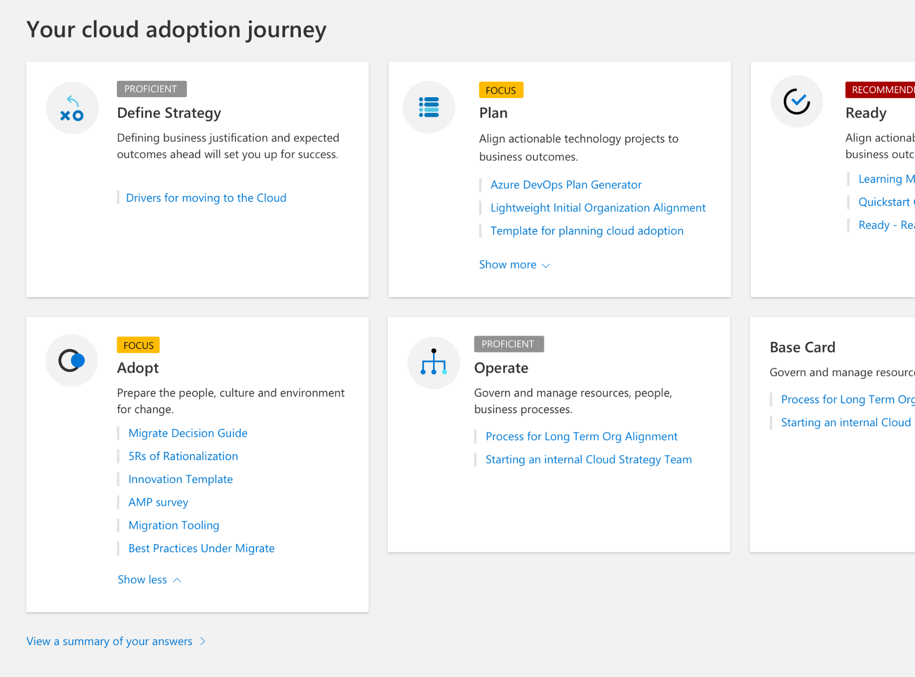
Before we begin…..
Let’s take a few minutes to capture the current state of your cloud adoption using the “Cloud Journey Tracker”.
Assess your cloud journey by reviewing the strategy and plan template.

Slide 7
Plan
Cloud adoption plans convert the aspirational goals of the cloud adoption strategy into actions. It will help guide technical efforts, in alignment with the business strategy.
1
Rationalize digital estate
Rationalize your digital estate to determine best approach to cloud adoption.
2
Initial org alignment
Align governance and cloud adoption to mitigate risks.
3
Skills readiness plan
Get your people ready by identifying skills gap and plan.
4
Cloud adoption plan
Create an actionable cloud adoption plan that aligns to your business strategy.

Slide 8


Plan | Initial organization alignment
Implementing Cloud adoption plan requires some initial alignment of different stakeholders who will make the plan a reality.
Cloud Adoption Team
Cloud Governance Team
Speed vs. Control
Create a balance between speed or moving quickly and control or reducing risks by have teams accountable for adoption and governance.
While cloud adoption team is required to execute cloud adoption tasks, governance team ensures processes and controls are implemented.
Notes:
Initial organization alignment is necessary as we work to build a cloud adoption plan

Slide 9
Plan | Rationalize digital estate
Cloud rationalization is the process of evaluating assets to determine the best approach to hosting them in the cloud (public or hybrid)
Rationalization can take place using an incremental approach or ‘Power of 10’ where the cloud strategy team selects the first 10 applications to be migrated which are a mix of simple and complex workloads; (recommended approach)
The output of a rationalization effort is a prioritized backlog of all assets that are affected by the chosen transformation.
Use costing models from your chosen cloud provider to forecast costs for your prioritized backlog; for Azure, we have pricing tools like Azure Migrate, Azure pricing calculator and Azure cost management. Ensure that hybrid is incorporated into the costing models.

Slide 10
Plan | The 5 Rs of Rationalization
Rehost
Refactor
Re-architect
Rebuild
Replace
Lift + Shift + Optimize
Here comes PaaS
Modernize monoliths
Scrap and Rebuild monoliths
Here comes SaaS

Slide 11
Plan | De-risk with cloud adoption horizons
Horizon | Objective | Time frame | Considerations
1. Migration and modernization | Prioritize the datacenter exit with a focus on modern platform as a service (PaaS) solutions over a basic lift-and-shift migration. | Months 0 - 18 | The migration as priority should minimize conflicts with existing innovation commitments.
2. Operation modernization | Prioritize operational improvements built on cloud-native governance, operations management, security, and compliance capabilities. | Months 6 - 18 | This effort complements and supports the primary migration effort.
3. Advanced modernization | With post-migration and operational improvements, the team will have sufficient data and cloud skills to perform deeper modernization of complex architectures. | Months 18-24
4. Innovation and growth | Redirect capital reduction from datacenter exits and new skills in central IT to focus on accelerating continued innovation. | Month 24+ | All prior horizons will produce a long list of new innovations as the central IT and cloud adoption teams create tighter collaborations and build out automation assets.

Slide 12
Plan | Skills readiness plan
Cloud computing is a technology shift, and a new set of skills are required to support cloud solutions.
Commoditized skills
Solution Manager
UI Designer UX Designer
Tester SDET
Developer
Application Operation & Support
Network Datacenter Engineer
Statistician Analyst
DBA Data Analyst
Relationship Manager
Trusted Advisor
Business Architect
Best use of assets
Process Engineer
Real-enough time
Engineering & DevOps
It works, build for monitoring self-healing
Edge/Wireless Networking
Secure, anywhere access
Cloud Architect
Secure, Anywhere access
Data Scientist
Business Insight
Information Architect
Trustworthy data
Strategic skills for the new era
1. Identify the gaps
2. Look across teams
3. Create an org-wide learning plan
Notes:
https://docs.microsoft.com/en-us/azure/cloud-adoption-framework/plan/suggested-skills

Slide 13
Plan | Cloud Adoption Plan
Translate strategy and effort into an actionable cloud adoption plan.
Prerequisites: Confirm that all prerequisite steps have been completed before you create your plan.
Define and prioritize workloads: Prioritize your first 10 workloads to establish an initial adoption backlog.
Align assets: Identify which assets (proposed or existing) are required to support the prioritized workloads.
Review rationalization: Review rationalization decisions to refine adoption-path decisions: Migrate or Innovate.
Define iterations and releases: Iterations are the time blocks allocated to do work. Releases are the definition of the work to be done before triggering a change to production processes.
Estimate timelines: Establish rough timelines for release planning purposes, based on initial estimates.

Slide 14
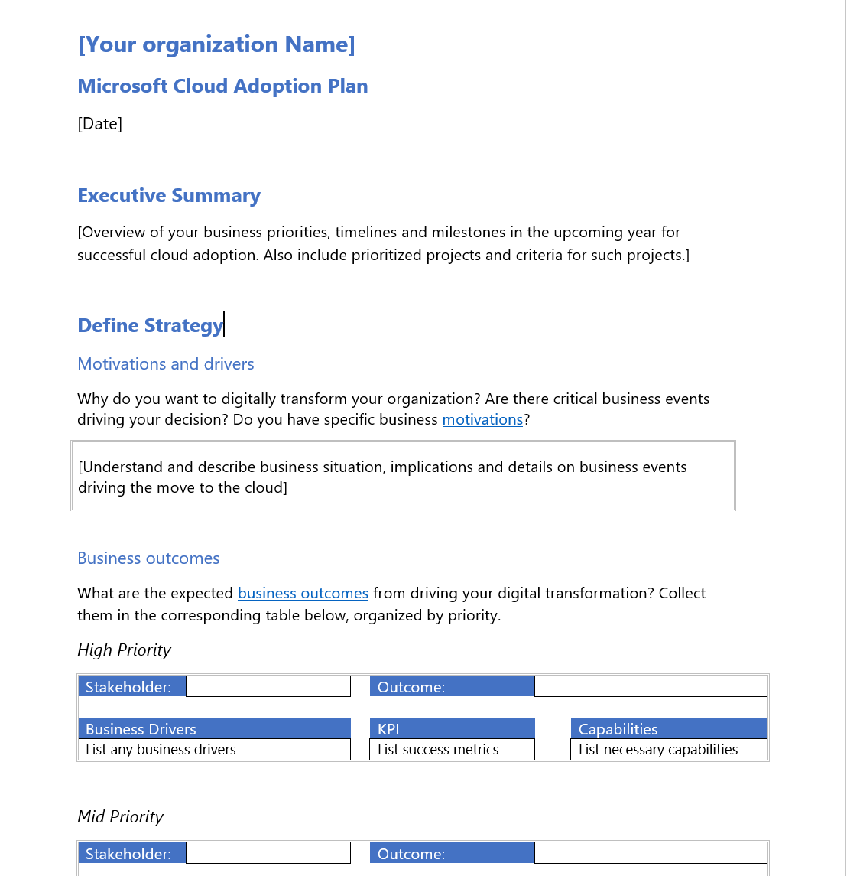
Strategy and Plan template
The Strategy and Plan template converts the aspirational goals of the cloud adoption strategy into an actionable plan
All the cloud teams leverage the cloud adoption plan to guide technical efforts, in alignment with business outcomes.
Download the template and get started with creating your plan.

Slide 15
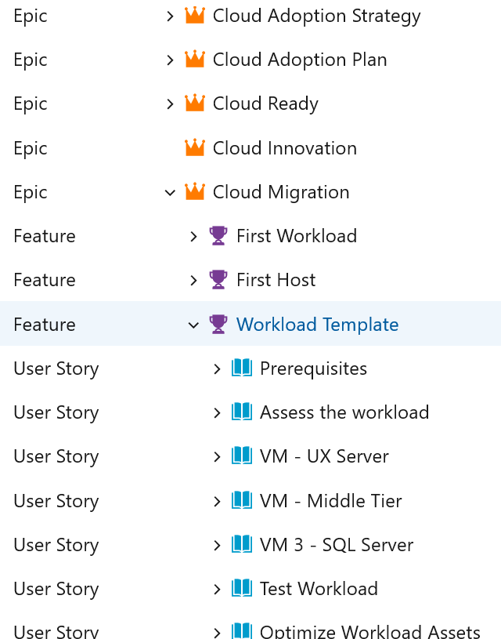
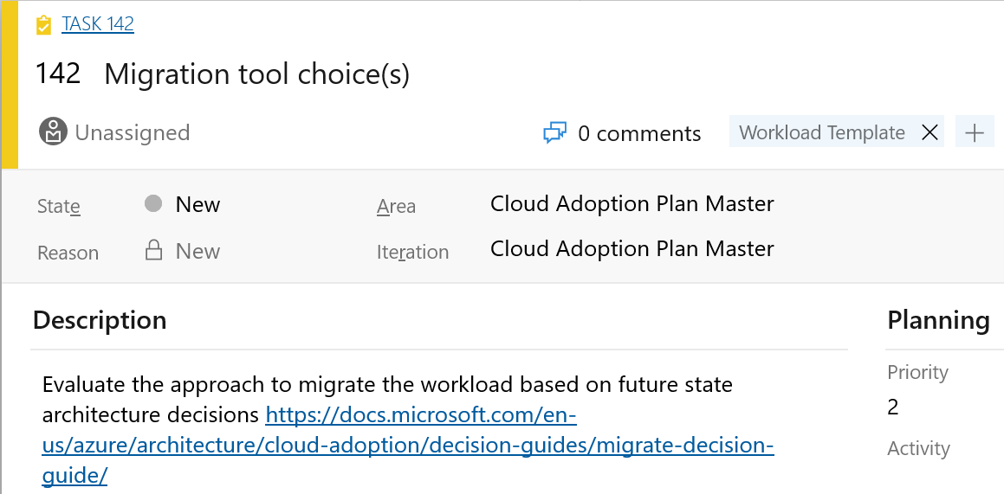
Azure DevOps cloud adoption plan generator
Leverage Azure DevOps to log and track your cloud adoption plan: aka.ms/adopt/plan

Slide 16

Workshop segment #2 Create your cloud adoption plan
Example:
How are you organizing your people and teams for cloud transformation?
Where does accountability reside for application creation and availability?
What are the current skills gaps?
How do your people train and skill up?
What is the prioritized list of applications you are moving to the cloud?

Slide 17
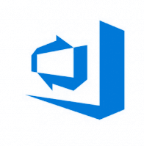
Next steps
Finalize the Strategy and Plan template
Take the Cloud Journey Tracker assessment & identify your cloud adoption needs
Build your cloud adoption plan
Deploy your cloud adoption plan with Azure DevOps
Choose your landing zone
Notes:
Microsoft Assessments offers several ways to measure your current state of cloud adoption, and provide guidance on what to do to move forward.
Thank you!

Slide 18

Thank you!

